Slide 1

Get OFF MY LAN! (Hacking in the80’s & 90’s)
A Part of the “1993 B.C.” Series
Antonio “Johnny Xmas” Martinelli
CISSP, GIAC - GPEN

Slide 2
$>whoami
#REDTEAMGO
GIAC-GPEN Penetration Tester
Penetration Tester for RedLegg International
Top-to-bottom, context & threat-based security assessments
Very large, global clients. Financial, Retail, eComm, nonprofit, etc.
Seriously vicious phishing campaigns
I rob banks

Slide 3
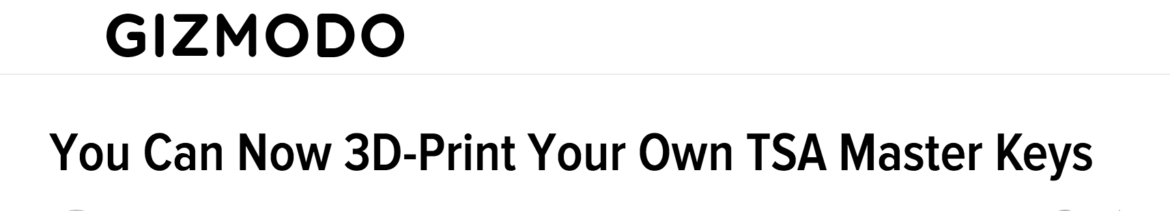


$>whoami
Notable Achievements
Speaker & Trainer at 25 conferences in 4 countries for the past 18 months.
Primary on the 3D Printed TSA Keys Leak
Time Magazine Man of the Year 2006

Slide 4
What IS hacking?
Two primary aspects:
The uncovering and dissemination of previously unknown knowledge
The use or exploitation of that knowledge to gain new or additional functionality

Slide 5
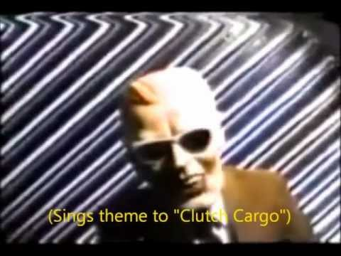
Cable TV piracy
Rabbit Hole: https://en.wikipedia.org/wiki/Max_Headroom_broadcast_signal_intrusion
Notes:
Where I got turned on to the concept that hacking was a thing
Telling this story because it gives you some great mindsets\
Or HOW I GOT TO BE A PENTESTER

Slide 6
Analog: best left to music
Cable used to be ANALOG!
That meant NO PHONING HOME. Now 2-way comms.
Pirates were not remotely detectable or easily targeted
Everyone got the SAME SIGNALS
Want a signal? Just splice in at the pole (or wherever)!
Targeting had to be done via broadcasts (just like LAN broadcasts)
Notes:
Cable boxes tracked by serial number

Slide 7

NSFW!
Notes:
Don’t linger. Discuss it on next slide

Slide 8
ANALOG: BEST LEFT TO MUSIC
Premium services were “scrambled” on the wire, and your box descrambled
“Descrambling” black boxes were cheap to make & sell
Didn’t actually descramble, just told the main box to do so
“Bullet Protectors” absorbed the “start descramble” signal
Tracing manufacturers of the “descramblers” was difficult
24/7 Descramblers and the Mike Tyson hat offer
Very easy to build
If you knew where to get the info. . . . . . . . .

Slide 9
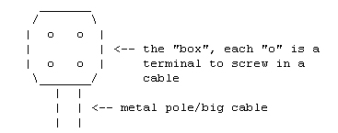
TEXTFILES!!
Notes:
Details on next slide

Slide 10
TEXTFILES!
Found scattered across hundreds of BBS servers
Lists of other sketchy BBS servers
Electronics \ Piracy hacks
Telco hacks \ scams
Anarchist’s Cookbook
Pornography
BBS HACKS
Warez
Exploits (SQLi, XSS, phishing tactics, etc) & 0days
Offensive software – WARDIAL.EXE !!
Rabbit Hole: http://textfiles.com/

Slide 11
BBS? Like from the uk?
Standalone servers
Usually in someone’s house
Usually had only one modem \ phone number
Usually someone’s actual & only house #
Often someone would answer the phone!
BBS (The Documentary): http://youtu.be/mJgRHYw9-fU
Notes:
BBS Documentary by Jason Scott

Slide 12
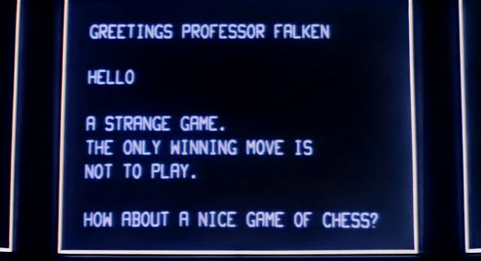
Wardialing!

Slide 13
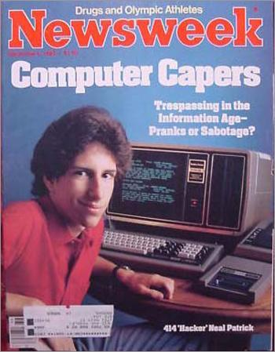
WARDIALING
Named after War Games. Usually a mainframe.
Provide list of #’s, or just area code + Interchange
Ring twice, hang up
Log anything with a carrier signal
Dialing direct to servers bypassed all perimeter security
Remember about there being no lockouts?
Rabbit Hole: https://en.wikipedia.org/wiki/The_414s
Notes:
Sometimes got you network equipment. Rarely an application server.
414s – Milwaukee-based hackers, the original Lulzsec. Broke into compnies via wardialing & default passwords, or via well-known security exploits. Leader got onto the cover of newsweek for these simple hacks.

Slide 14
Internet hacki- Uh. . .”pentesting”
TONS OF STUFF ALSO HAD A PUBLIC IP!!
SSH & SSL-Over Telnet didn’t exist \ Weren’t used
Every server ran FTP. . .as root
What’s all that mean??

Slide 15
Get root, sniff creds, own domain.
Everything was Unix; mostly IBM & Solaris
Crashing FTP service run as root gets you what?
Simple buffer overflows were surprisingly successful
Fire up tcpdump, and grab credentials all day. Reuse everywhere.
Tcpdump didn’t have ASCII output
Account lockouts were also nonexistent.
4 or 6-character passwords were common, sometimes mandatory

Slide 16
LOL. Just LOL.
Firewalls, like all brand-new tech, were poorly configured
IDS’, like all brand-new tech, were poorly configured
Signatures suuuuuucked
Bypassing them was often as easy as randomizing your scanning
And then Microsoft Released IIS. . .

Slide 17
Stuff people who weren’t me did
The World Wide Web Superhighway was yours to command
Deface websites
Hold entire sites \ domains hostage
Intercept sensitive \ confidential communications & information, then walk through the front door with them
See also: Dumpster Diving
Notes:
Extortion

Slide 18
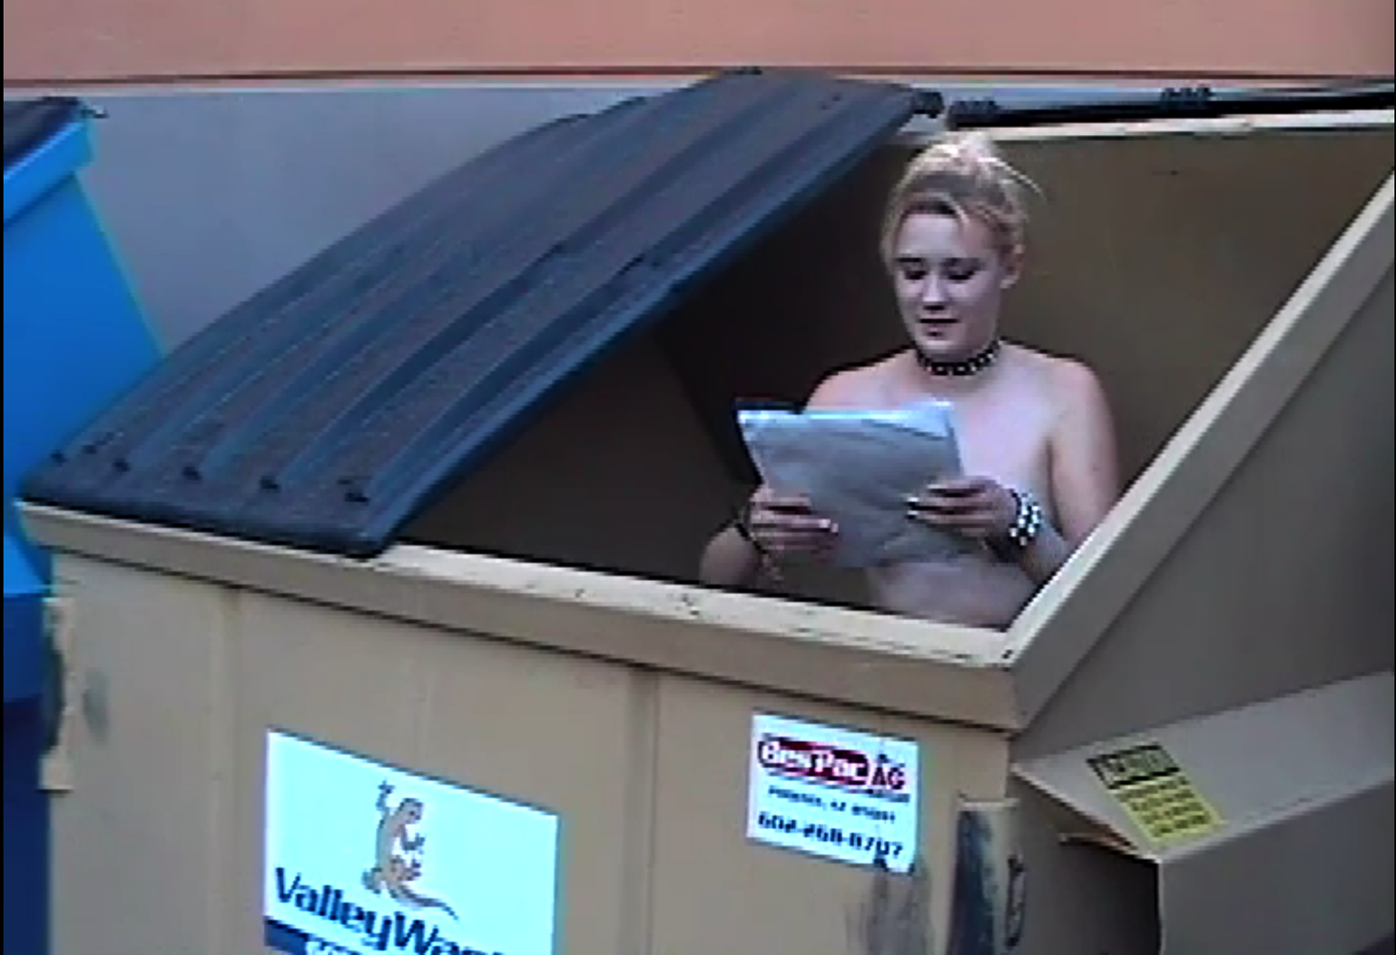
Dumpster diving!

Slide 19
Dumpster diving!
As fun as it sounds!
OK, it wasn’t actually that bad. You wouldn’t do it at restaurants.
Incredibly successful outside of Big Box stores
Circuit City, Best Buy, Walgreens \ Osco \ CVS \ Duane Reede
Plaintext credit card numbers & exp. dates! NO CVV NEEDED!
Ship to your neighborhood abandoned house!
Notes:
Order stuff and have it shipped to your local abandoned house

Slide 20
HACKERS VS CRACKERS (1995)
White Hat Vs Black hat
Hackers were the purest life forms
Seeking out and sharing all possible knowledge
“Fighting for the users” – occasionally against evil organizations
Crackers were unskilled, malicious pirates
Writing viruses, taking over servers, defacing websites, stealing info
Rabbit Hole: IETF RFC1392 http://www.rfc-archive.org/getrfc.php?rfc=1392
Notes:
Rise of internet forums & IRC
RFC Definition of Cracker in the Internet Glossary

Slide 21
HACKERS VS CRACKERS (Y2K)
Essentially Black Hat vs Very Dark Gray Hat
Nobody dared claim to be a hacker
You were only referred to as one
Claiming this without being established resulted in immediate attack
Crackers focused ONLY on bypassing security measures
Almost exclusively wrote keygens, primarily using SoftIce
Often regarded as less talented, as most were script kiddies

Slide 22
HACKERS VS CRACKERS (NOW)
It’ all the same. :-/

Slide 23
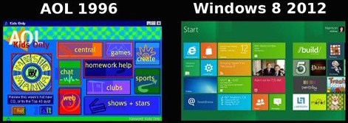
Information superhighway vulnerability exploitation methodologies!
Notes:
Those who cannot remember the past are condemned to repeat it – George Santayana, Spanish philosopher

Slide 24
LANd ATTACK
DoS by sending SYN with Src IP = Dst IP
Affected Windows NT, 95, HP-UX, some printers in 1997.
Patch simply commented out problem code
Discovered to affect Windows 98 – 2003 Server in 2005
New dev simply uncommented the old code
“Wish you could still sue an old exploit? Just wait long enough” – Tim Medin
Notes:
Apple’s famous iOS lockscreen bypass

Slide 25
Information superhighway vulnerability exploitation methodologies!
Today’s most common web exploits are VERY old
As old as SQL
As old as JAVASCRIPT
As old as Webmail
As old as . . .well, BROWSERS themselves
Notes:
Discuss SQLi – We just called it “SQL,” and were mostly exploring. Occasionally you would get PW dumps, but rarely find anything great (talk about this later)
Discuss CSS – Reading private journal entries on Livejournal
Yahoo phishing story

Slide 26
Information superhighway vulnerability exploitation methodologies!
So why didn’t we hear much about them before 5-10 years ago?
Mostly used by benign pranksters & One-off criminals
Organized crime was mostly just spreading profitable adware
DDoS hostaging was easy, and quite lucrative (still is)
APT countries had very limited Internet access
eCommerce was still in its infancy
Less transactions = less to steal
Very little in-house processing
CYBER was not marketable / being marketed

Slide 27
Information superhighway vulnerability exploitation methodologies!
Soooooo why is this STILL A PROBLEM 5-10 years later?
Security is an afterthought:
We create a product, and then (if we’re lucky) ask if it’s secure
Our developers are not being trained in secure practices
ESPECIALLY true for non-IT products, such as INTERNET OF THINGS
We are concerned only with quickly pushing a product to market
QA borders on nonexistent, and rarely involves a security assessment
Assessments result only in more work that does not improve the user experience or product quality
Notes:
Security check is often done after product ships

Slide 28
FIN
Let Me Pwn You!
http://www.redlegg.com
Hang Out with Me at BurbSec!
http://www.meetup.com/burbsec
http://burbsec.com
My Slides & Videos:
https://github.com/johnnyxmas/Talk_Decks

